Slide 1
AXI VIP
Final Project
BY HANEESH KUMAR D
RN 123

Slide 2
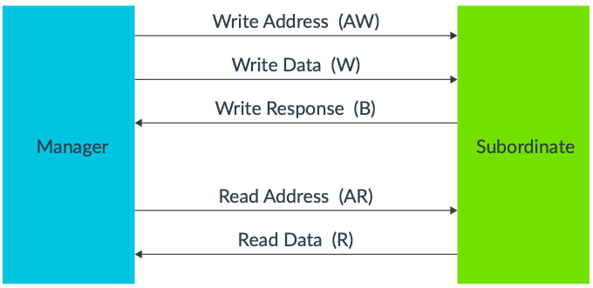
Introduction to AXI Protocol
Communication Protocol of the AMBA family, released by arm for high performance IPs such as Processor and memory units.
Burst based protocol, supporting three types of transactions such as Fixed, Increment and Wrap.
The protocol is implemented by means of 5 channels, namely Write Address (AW), Write Data (W), Write Response (B), Read Address (AR) and Read Data/Response (R).
Each Channel makes use of a handshake mechanism to facilitate data transfer.

Slide 3
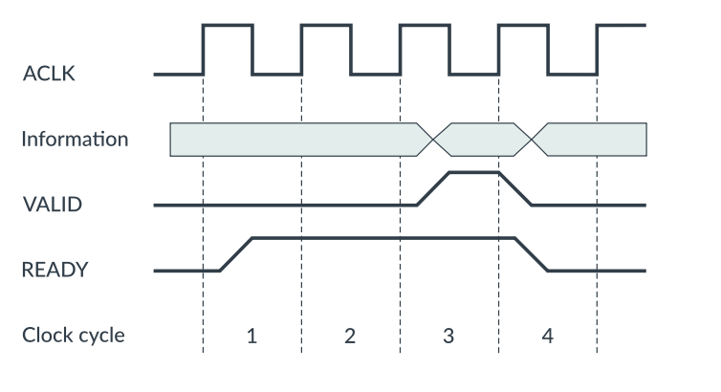
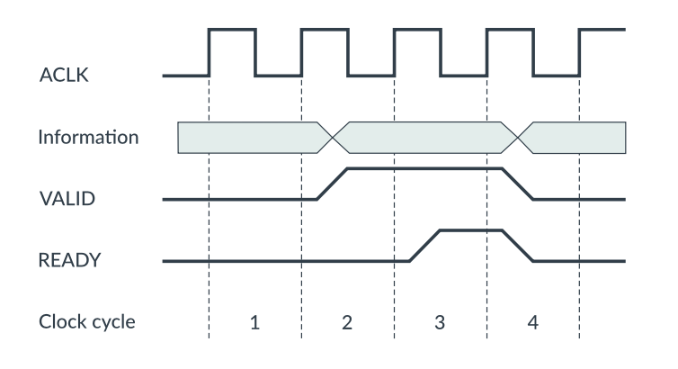
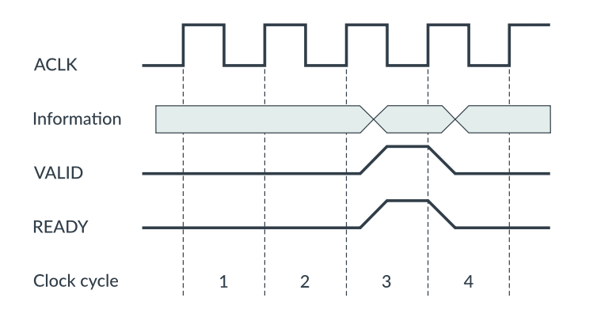
Handshake Mechanism
Case 1
Case 2
Case 3
Case 1 : Ready asserted before valid. Handshake completed @ 4 clock cycle.
Case 2 : Ready asserted after valid. Handshake completed @ 4 clock cycle.
Case 3 : Ready asserted with valid. Handshake completed @ 4 clock cycle.

Slide 4
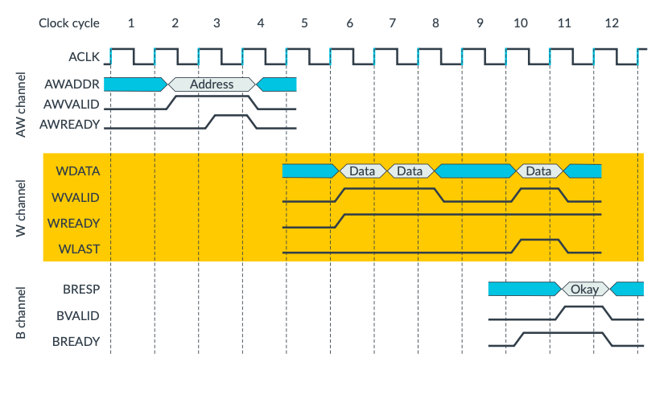
Write Data Transaction

Slide 5
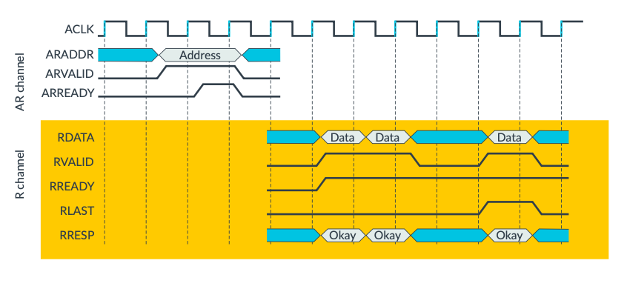
Read Data Transaction

Slide 6
Main Features of AXI
Independent read and write channels : Having two independent sets of channel helps to improve the bandwidth performances of the interfaces.
Multiple outstanding addresses : a master can issue transactions without waiting for earlier transactions to complete.
No strict timing relationship between address and data operations : a master could issue a write address on the Write Address channel, but there is no time requirement for when the master must provide the corresponding data to write on the Write Data channel.
Out-of-order transaction completion : The AXI protocol includes transaction identifiers, and there is no restriction on the completion of transactions with different ID values.
Support for unaligned data transfers : The first bytes accessed can be unaligned with the natural address boundary.
Burst transactions based on start address : AXI masters only issue the starting address for the first transfer. For any following transfers, the subordinate will calculate the next transfer address based on the burst type.

Slide 7
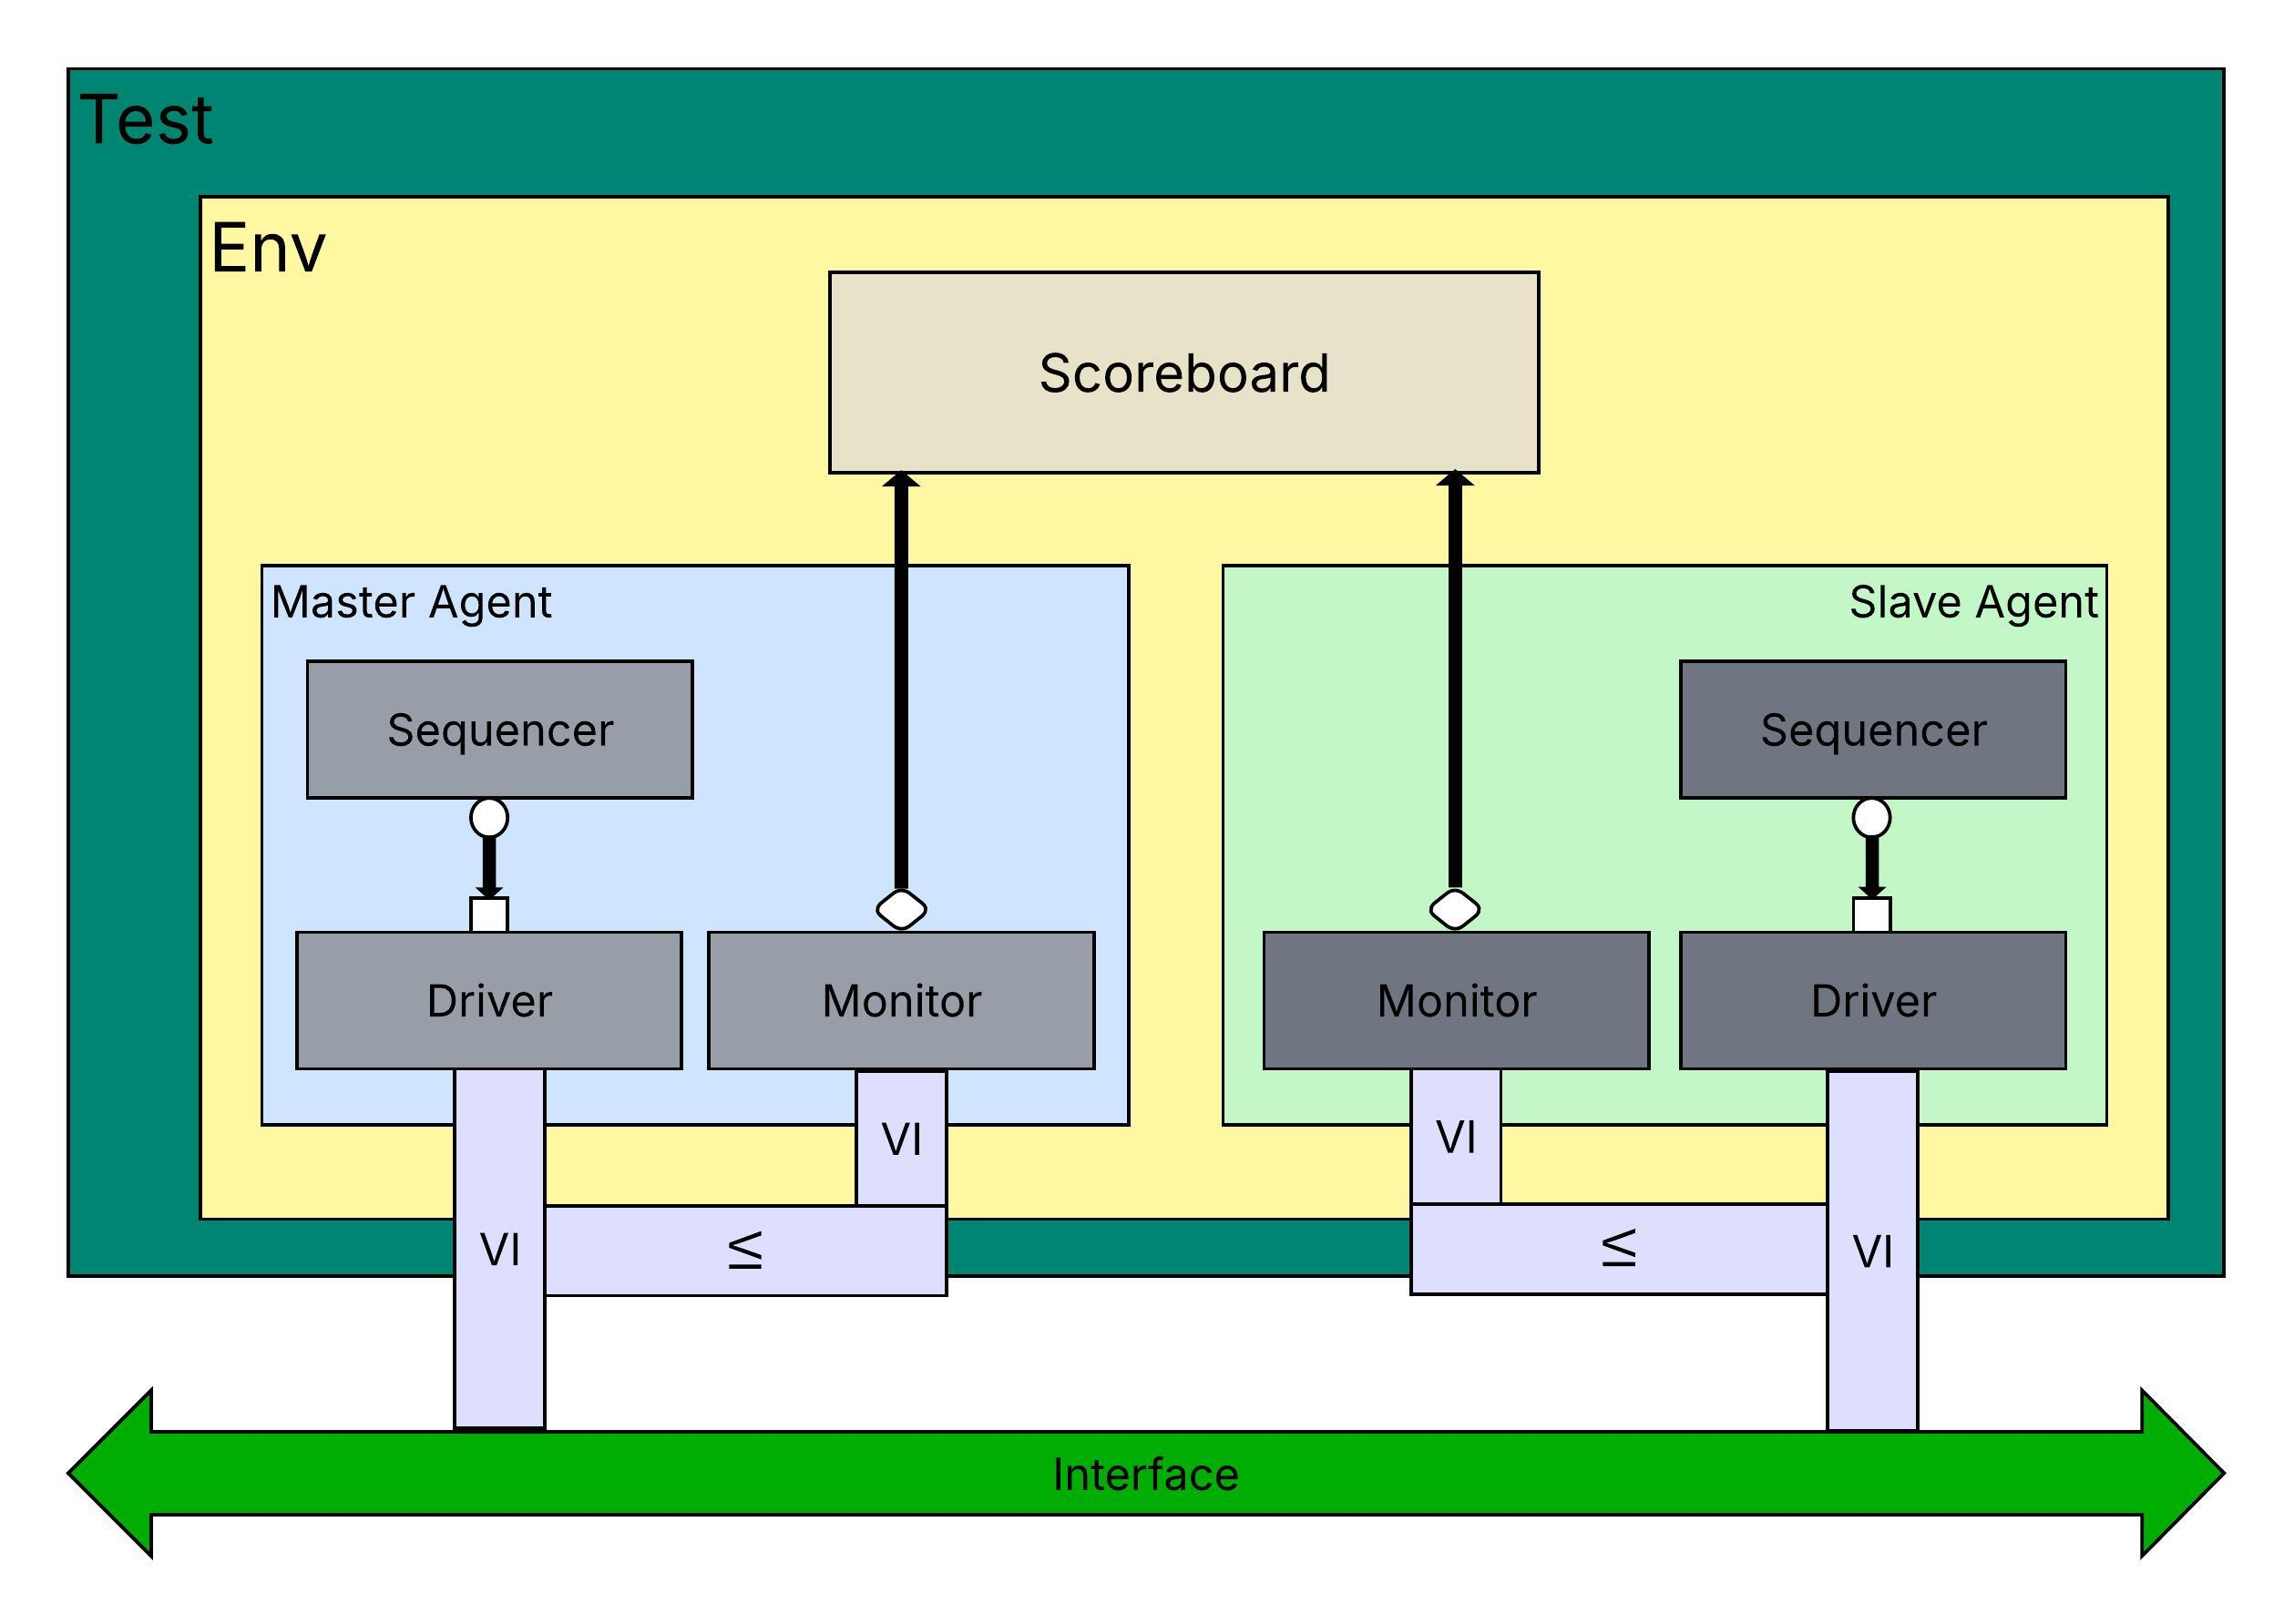
TB Architecture

Slide 8
Test Cases
Transaction Type | Signal | Description | Application
Fixed Transaction | AxBURST == 2’b00 | Supports Unaligned address. Writing to and Reading from the same location for each transfer | FIFO
Increment Transaction | AxBURST == 2’b01 | Supports Unaligned address. The first transfer is written/read at the start address. Consecutively at aligned addresses as calculated by slave. | Sequential Memory Access
Wrap Transaction | AxBURST == 2’b10 | Similar to Increment Transaction. But upon reaching a upper address boundary limit, the address to write/read from wraps around to a boundary called wrap boundary | Cache Memory

Slide 9
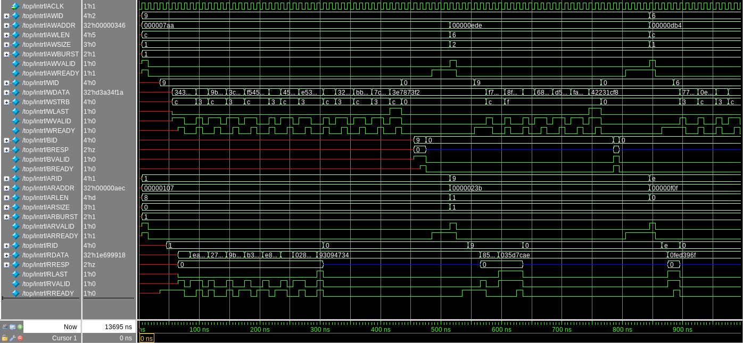
Waveform

Slide 10
Coverage Model
WTX_COV
Cover variable | Bins | Values
wr_adress | lower | 32'd0 - 32'd2047
 | higher | 32'd2048 - 32'd4098
wr_length | small | 0 - 4
 | medium | 5 - 10
 | large | 11 - 15
wr_burst_size | 1_byte | 0
 | 2_byte | 1
 | 4_byte | 2
wr_burst_type | fixed | 0
 | increment | 1
 | wrap | 2
wr_data | lower | 32'd0 - 32'h7fff_ffff
 | higher | 32'h8000_0000 - 32'hffff_ffff
wr_strb | 1_byte | 1,2,4,8
 | 2_byte | 3,12
 | 4_byte | 15
wr_resp | okay | 0
RTX_COV
Cover variable | Bins | Values
rd_adress | lower | 32'd0 - 32'd2047
 | higher | 32'd2048 - 32'd4098
rd_length | small | 0 - 4
 | medium | 5 - 10
 | large | 11 - 15
rd_burst_size | 1_byte | 0
 | 2_byte | 1
 | 4_byte | 2
rd_burst_type | fixed | 0
 | increment | 1
 | wrap | 2
rd_data | lower | 32'd0 - 32'h7fff_ffff
 | higher | 32'h8000_0000 - 32'hffff_ffff
rd_resp | okay | 0

Slide 11
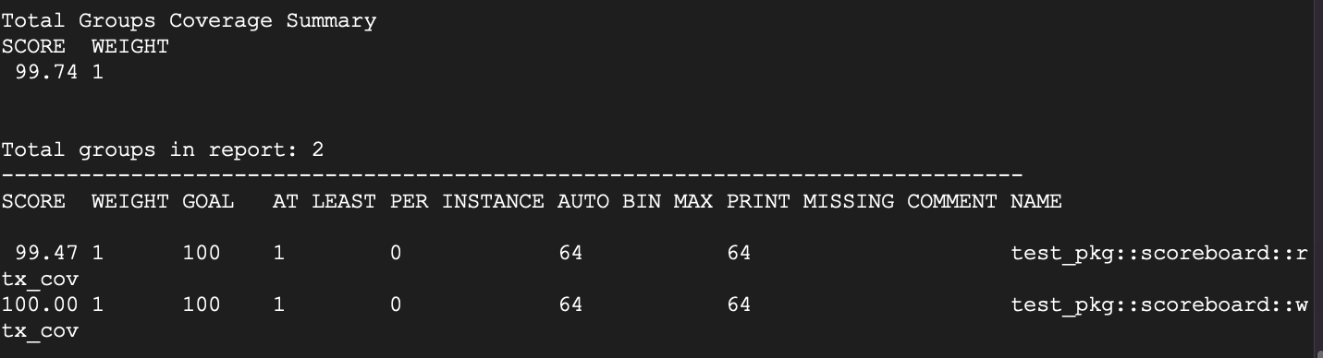
Coverage Model

Slide 12
Assertions
Handshake mechanism, Once Valid and Ready are asserted, then at least one of them should be de-asserted in the next clock cycle.
The slave must wait for AWVALID, AWREADY, WVALID and WREADY to be asserted before asserting BVALID.
The slave must wait for the last write data transfer before asserting BVALID.
The slave must wait for both ARVALID and ARREADY before asserting RVALID to indicate that valid data is available in the Read Data Channel.

Slide 13
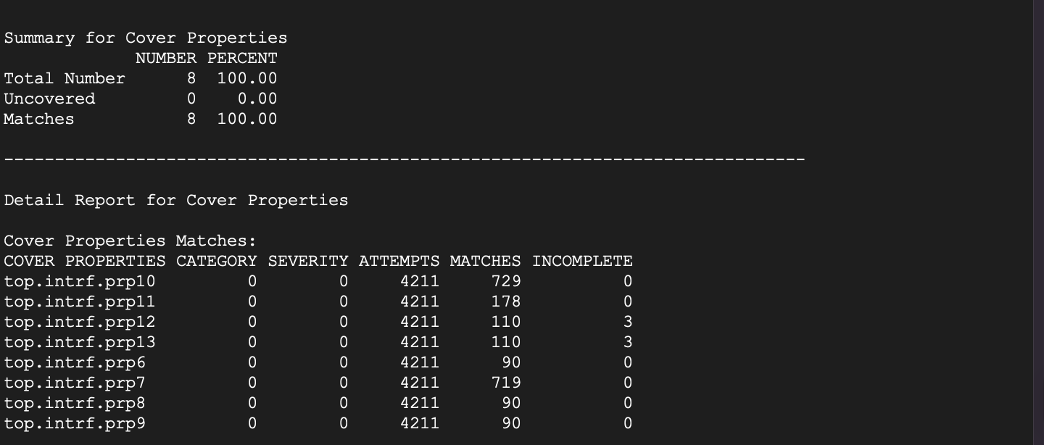
Assertions Coverage

Slide 14
Thank you.

Slide 15
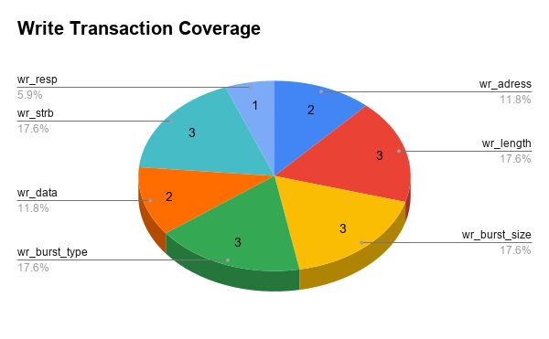
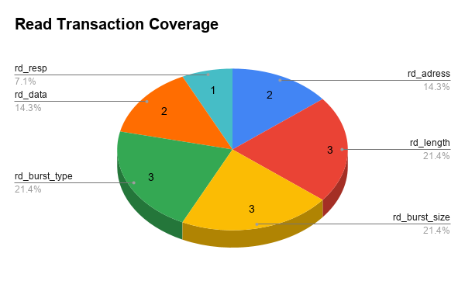
Coverage Model

